Slide 1
HAPPINESS AND WELL BEING

Slide 2
WHAT IS HAPPINESS?
A happy person is someone who experiences frequent positive emotions, such as joy, interest, and pride, and infrequent (though not absent) negative emotions, such as sadness, anxiety and anger (Lyubomirsky et al., 2005)

Slide 3
Broadly speaking, happiness is related to the experience of positive emotions.
Important to note that positive emotions do not mean absence of negative emotions.

Slide 4
CONTINUED…
A happy person is not someone who is inherently happy or has more positive events happen to them, it is about the response to situations.
Different people have defined happiness differently…….
The ancient Greeks defined happiness as: "Happiness is the joy that we feel when we’re striving after our potential."

Slide 5
Some psychologists have suggested that happiness consists of three distinct elements: the pleasant life, the good life, and the meaningful life (Seligman, 2002; Seligman, Steen, Park, & Peterson, 2005).
The pleasant life: the attainment of day-to-day pleasures
The good life: identifying our unique skills and abilities and engaging these talents to enrich our lives
The meaningful life: deep sense of fulfillment that comes from using our talents in the service of the greater good

Slide 6
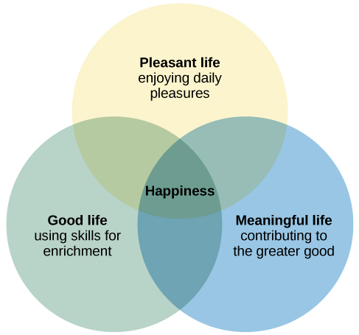
Notes:
the action of improving or enhancing the quality or value of something.

Slide 7
Who is the founder of Positive Psychology?
Martin Seligman:
As President of American Psychological Association (1998) set new goals for the discipline of Psychology : Exploring what makes life worth living and building enabling conditions of a life worth living
Shift from happiness (Happiness Theory) to Well Being (Well being Theory)
Happiness Theory attempted to explain happiness in terms of life satisfaction
Well being theory improved upon the Happiness theory
Notes:
the state of being comfortable, healthy, or happy.

Slide 8
THE PERMA MODEL
P – Positive Emotion
E – Engagement
R – Relationships
M – Meaning
A – Accomplishments

Slide 9
Result of the longest running study by Harvard
Robert Waldinger – TED Talk
Notes:
https://www.health.harvard.edu/blog/the-secret-to-happiness-heres-some-advice-from-the-longest-running-study-on-happiness-2017100512543
https://www.ted.com/talks/robert_waldinger_what_makes_a_good_life_lessons_from_the_longest_study_on_happiness?language=en

Slide 10


